Slide 1
Welcome
To our presentation on advance programming
Automobile Data Analysis using Python
A Data-Driven Insight into Car Performance & Pricing

Slide 2
PRESENTED BY
SANZIDA AKTER SHEMO
2304001
PALLAB KUMAR DAS
2304053
MD.TAOJIR AHMED PATWARY
2304032

Slide 3
PROJECT SUPERVISOR
Dr. Umme Fawzia Rahim
Assistant Professor
Department Of Computer Science & Engineering
DUET, GAZIPUR
Dr. Md. Shohidul Islam
Professor
Department Of Computer Science & Engineering
DUET,GAZIPUR

Slide 4
introduction
Automobiles are an essential part of modern life, and every vehicle comes with different features such as price, engine type, horsepower, mileage, fuel type, and safety levels. Understanding these features helps customers, companies, and researchers make better decisions.
In this project, we analyze an automobile dataset using Python to understand how different car attributes affect performance and pricing. Data analysis helps identify pattern. For example, which cars are more fuel-efficient, which engines give more power, and how price changes with features like horsepower or number of cylinders.

Slide 5
Real-life applications
Price prediction
Performance comparison
Fuel efficiency study
Market research

Slide 6
PROJECT OBJECTIVES
To clean and prepare the automobile dataset
To analyze key features like price, horsepower, mileage, and engine type
To compare different types of cars (fuel, engine, cylinders, drive wheels)
To visualize data using graphs and charts
To extract useful insights for understanding car performance and pricing
We want to study the car dataset, clean the data, compare features, make graphs
, and understand how different features affect a car’s price and performance.

Slide 7
Tools & Libraries
Python
Pandas (data cleaning, manipulation)
NumPy (math operations)
Matplotlib (visualization)
Seaborn
VS Code

Slide 8
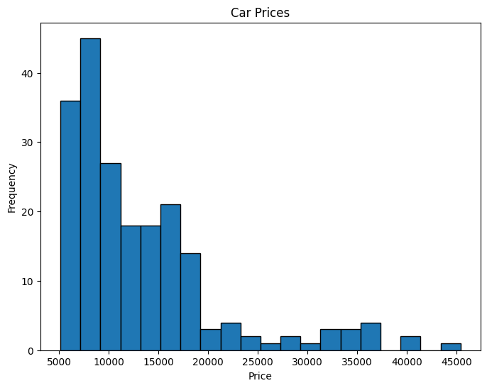
Price analysis

Slide 9
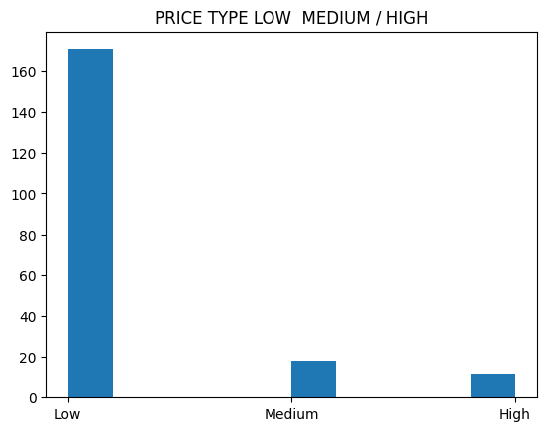

Slide 10
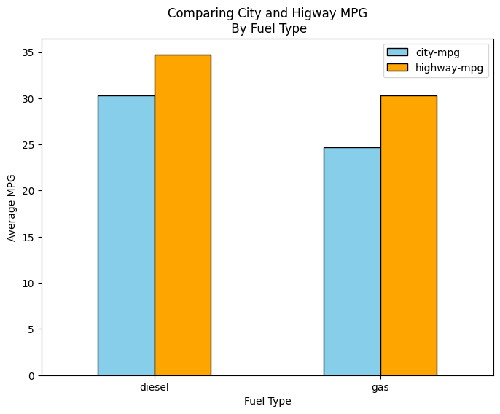
Fuel Type Analysis

Slide 11
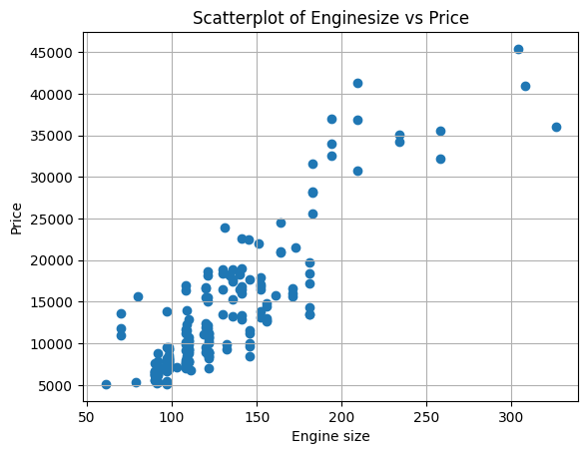
Engine Type Analysis
"This scatter-plot shows a strong positive correlation between engine size and price. As the engine size increases, the price of the vehicle also tends to rise significantly. This indicates that engine capacity is a major factor in determining a car's market value."

Slide 12
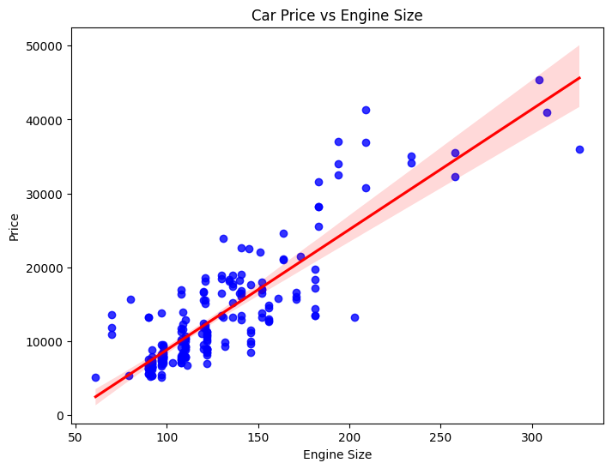

Slide 13
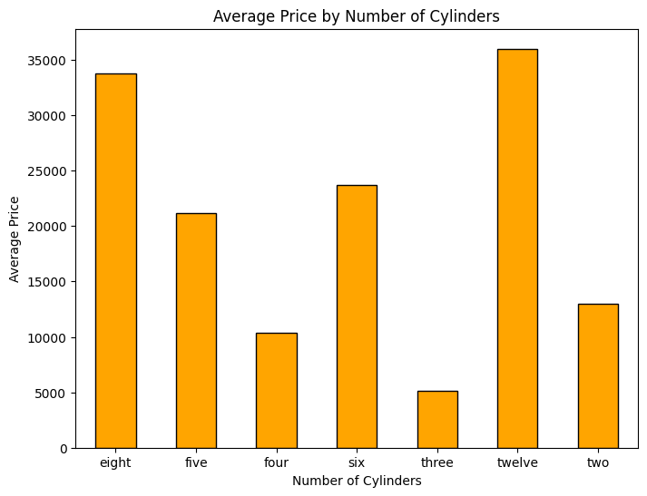
Cylinder Analysis

Slide 14
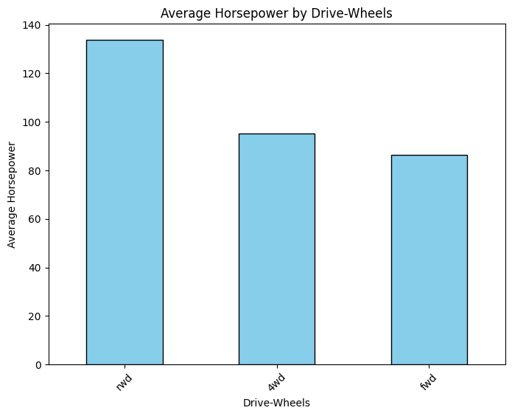
Drive Wheels Analysis

Slide 15
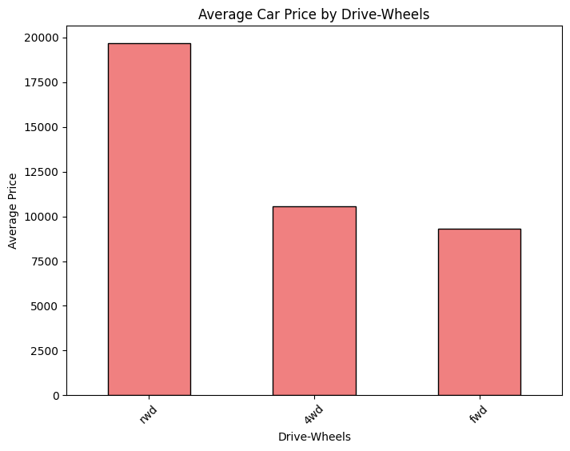

Slide 16
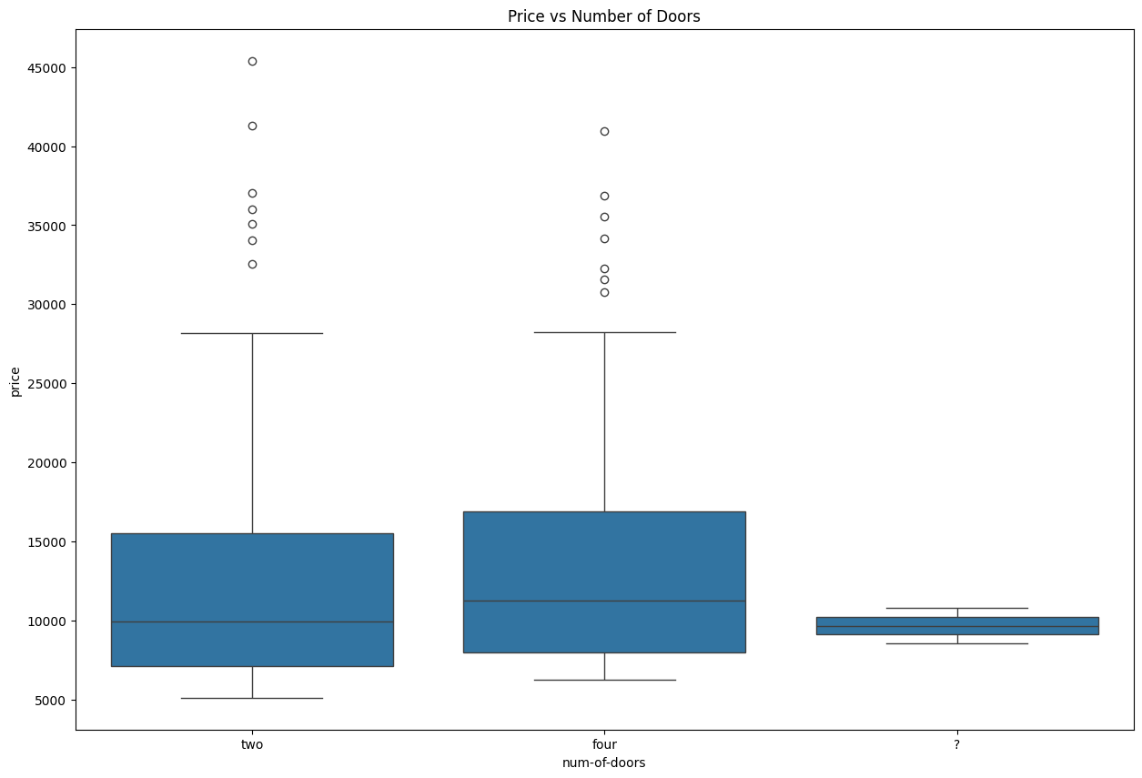

Slide 17
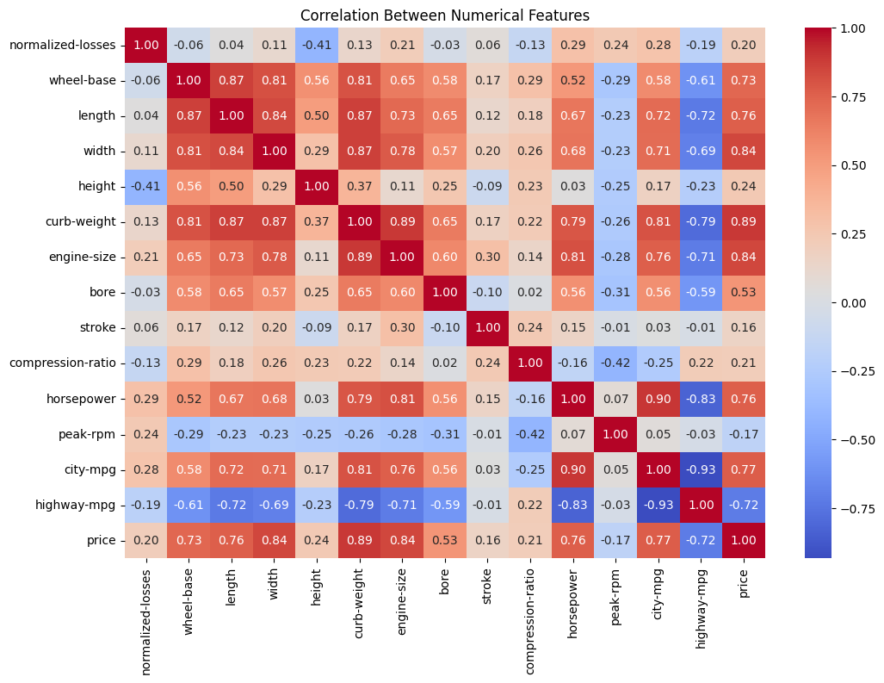
Correlation Analysis

Slide 18
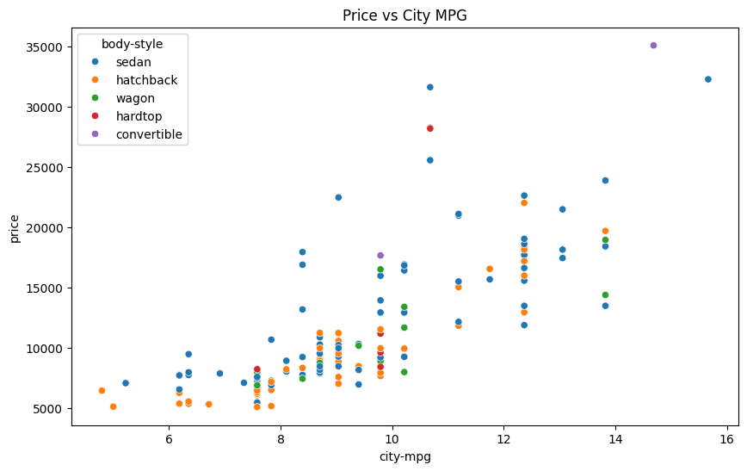

Slide 19
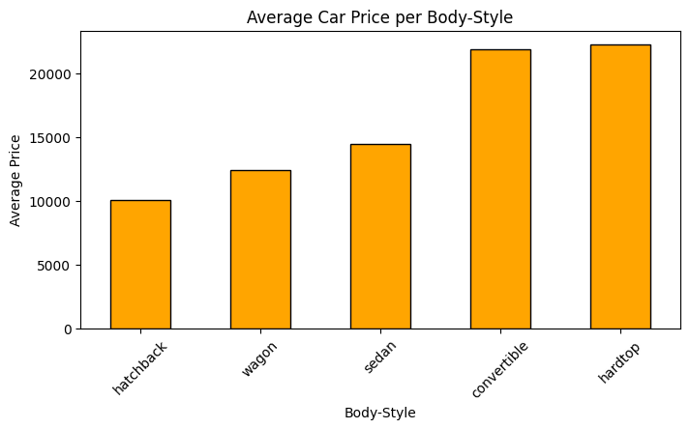
This chart shows a clear relationship between body-style and price. Premium styles like Hardtops and Convertibles have the highest average prices, while utility styles like Hatchbacks are the most affordable. This proves that a car's design significantly influences its market value."

Slide 20
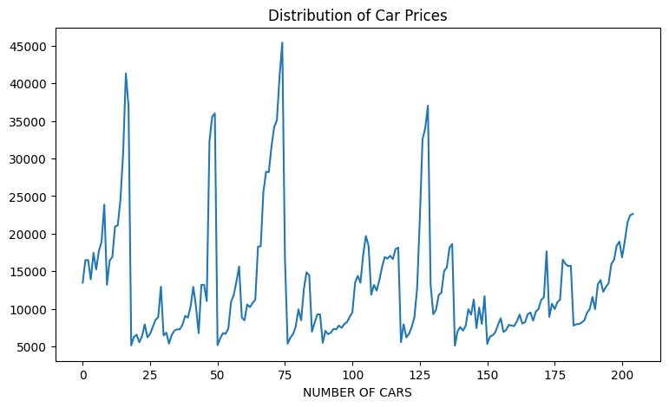

Slide 21
Key visualization

Slide 22
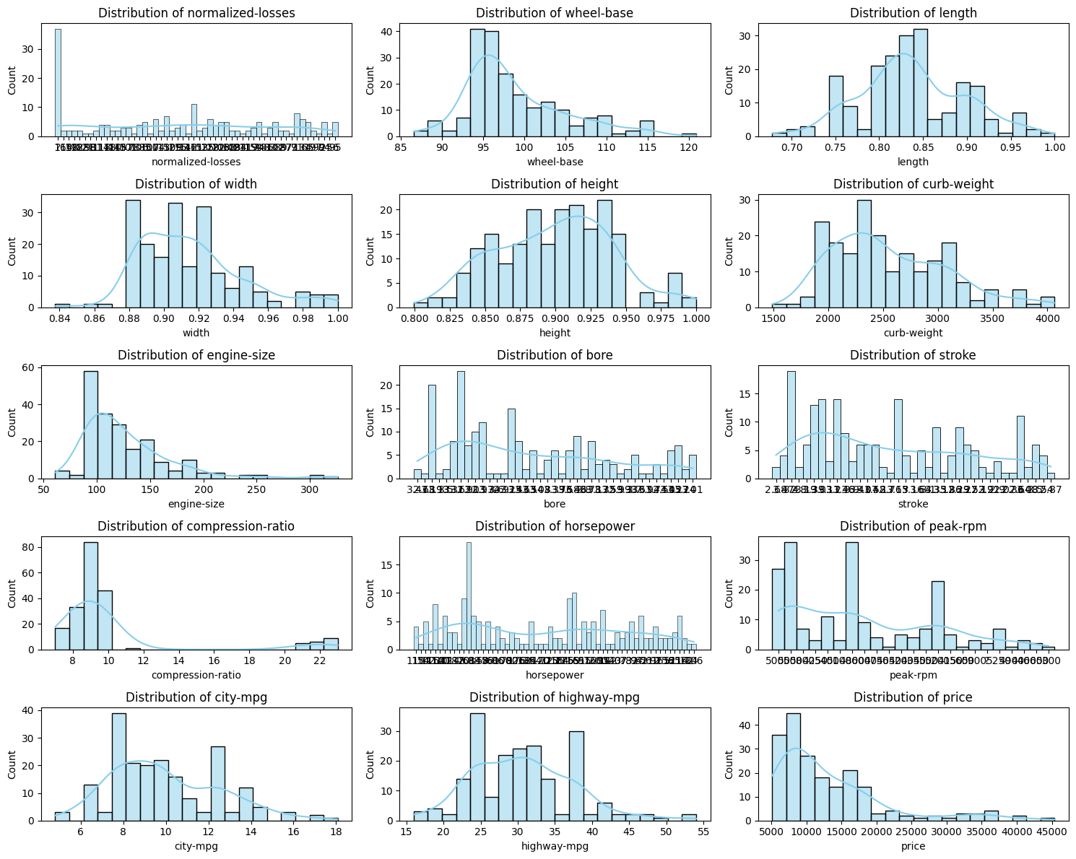

Slide 23
Final Findings & Insights
Fuel Type: Diesel vehicles are more fuel-efficient but often cost more than gasoline vehicles.
Cylinders: Cars with more cylinders produce more horsepower and are priced higher, while smaller engines offer better mileage.
Drive Wheels: Rear-Wheel Drive cars are more performance-oriented and expensive, while Front-Wheel Drive cars are lighter and fuel-efficient.
Price Correlation: Price is strongly correlated with features like horsepower, weight, and engine type. Luxury brands and high-performance cars are more expensive.
Mileage vs Price: Cars with fewer cylinders and better mpg are more economical, while high-performance cars sacrifice fuel efficiency for power.

Slide 24
Future Work
In the future, this project can be expanded in several useful directions. We can work with a larger and updated dataset that includes more car models and more detailed features such as safety ratings, resale value, maintenance cost, and customer reviews.
Another improvement is performing brand-wise and country-wise comparisons to study how cars differ globally.
We can also apply machine learning models to predict car price, mileage, horsepower, or even classify cars based on their features.

Slide 25
Conclusion
In the future, we can add machine learning, use a bigger dataset, make dashboards, and create tools that allow users to compare cars online.
Finally, the project can evolve into a web-based car comparison tool, where users can select features and instantly see performance differences.
Thank You

